Slide 1

Features Impacting Residential Solar Project Costs in San Diego, California
Christopher Fischer - 011933891
College of Information Technology, Western Governors University
Dr. Daniel Smith
January 4, 2025

Slide 2

Agenda
Introduction
Problem Statement
Data Analysis Process
Findings
Limitations
Recommendations
Expected Benefits

Slide 3

Introduction
Founder, Noéo Solutions, Inc.
BS in Business Administration
MS in Data Analytics
35 years designing and building data-centric applications
25 years energy and water utility expertise

Slide 4

Problem Statement
To what extent can the features of a proposed residential solar project (system size, single/multi-phase, self-installed, number of modules, module capacity, module efficiency, and battery capacity) affect its total installed cost?
Baseline Assumption (H₀) - The selected features do not have a significant impact the total project cost
Alternate Claim (H_{a}) - The selected features do have a significant impact the total project cost

Slide 5

Data Analysis Process
Data Acquisition
1
Data Preparation
2
Data Exploration
3
Predictive Modeling
4

Slide 6

Data Acquisition
Source: Lawrence Berkeley National Laboratory’s Tracking the Sun project
Solar installations across 31 states
3.7M observations
55 variables

Slide 7

Data Preparation
Extracted data for residential projects installed during 2023 in the San Diego metro
Data anonymized for compliance with privacy rules
Incomplete observations removed
Outliers removed
Values normalized
Result: 41,336 projects included in the study

Slide 8

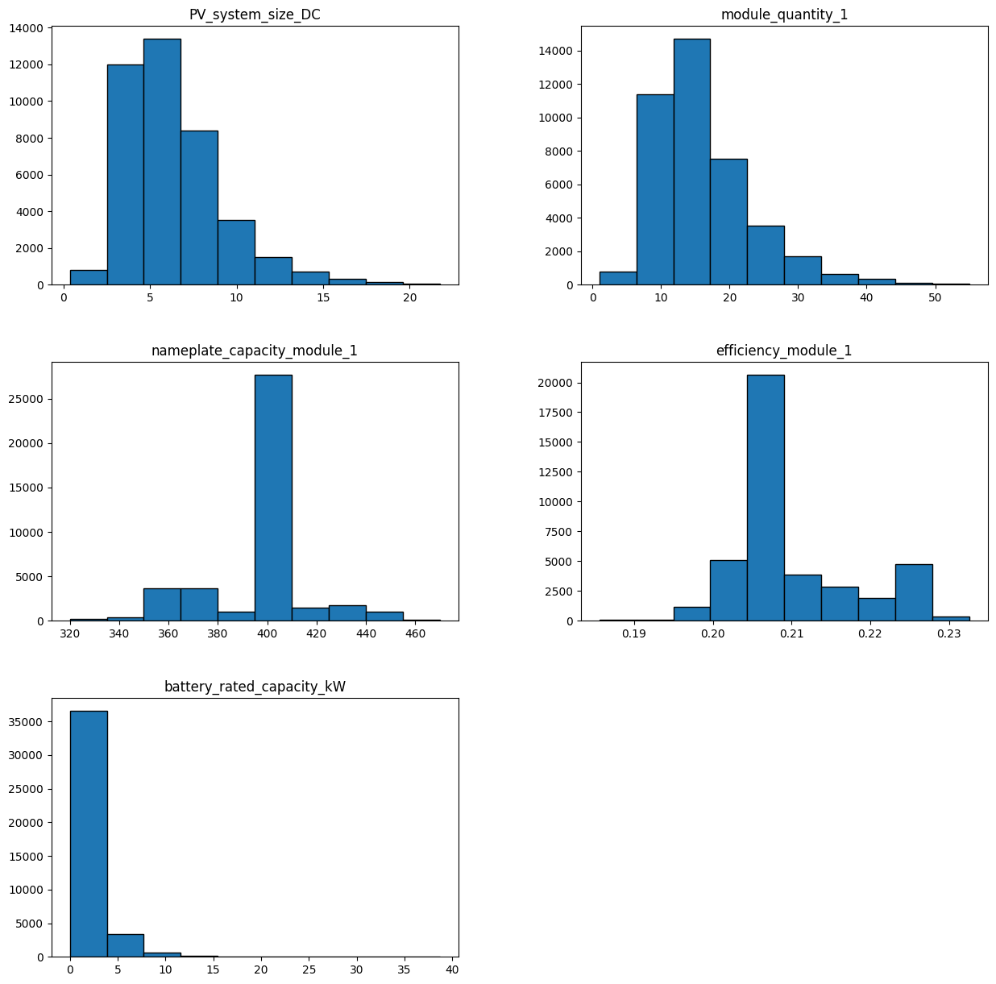
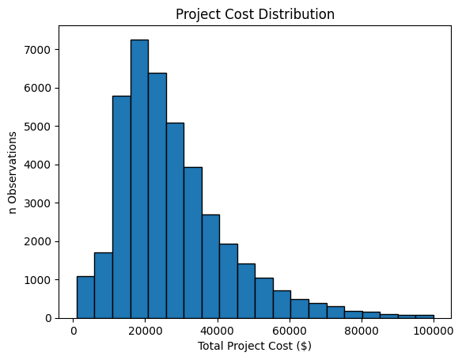
Data Exploration
Distributions

Slide 9
Data Exploration
Distributions

Slide 10
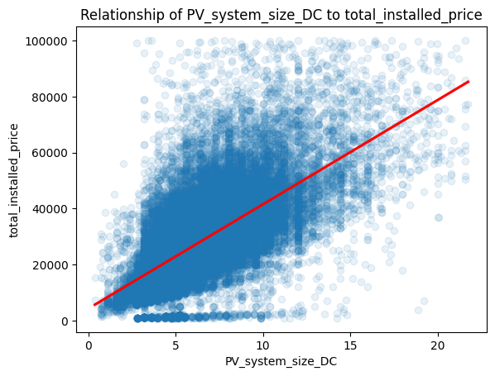
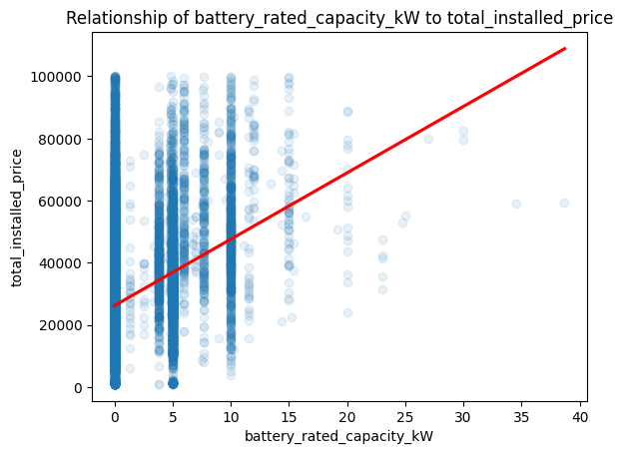
Data Exploration
Scatter Plots with Trend

Slide 11
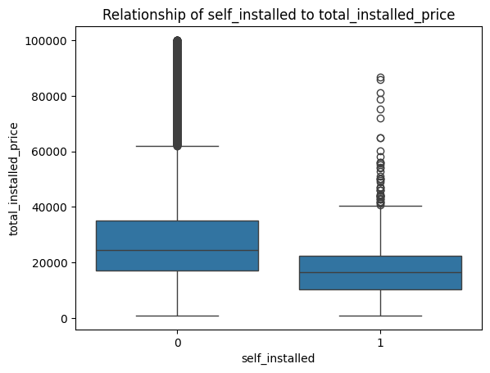
Data Exploration
Box Plot

Slide 12
Data Exploration
Box Plot

Slide 13
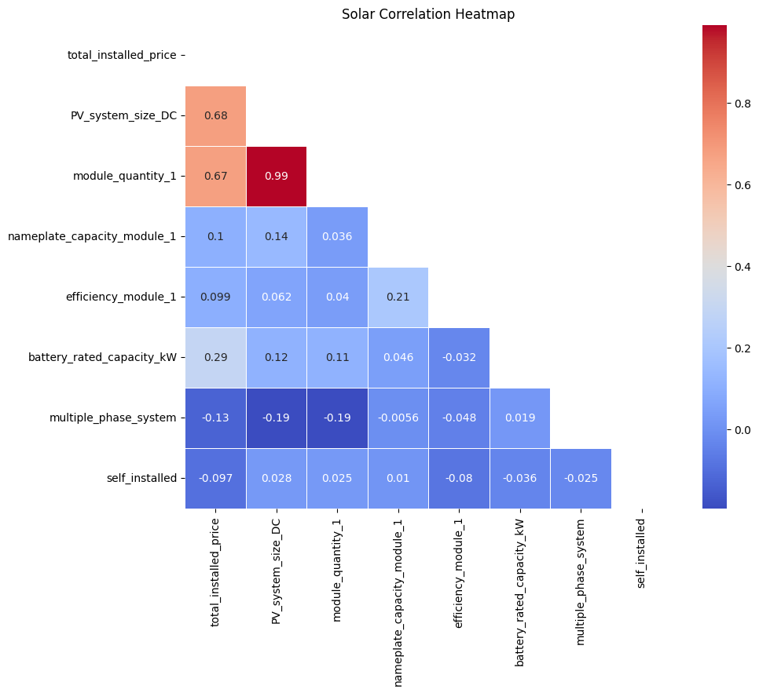
Data Exploration
Correlation

Slide 14

Multiple Linear Regression
Analyzes multiple factors affecting outcomes simultaneously
Measures each variable's impact
Provides clear performance metrics
Offers proven, standard methodology

Slide 15

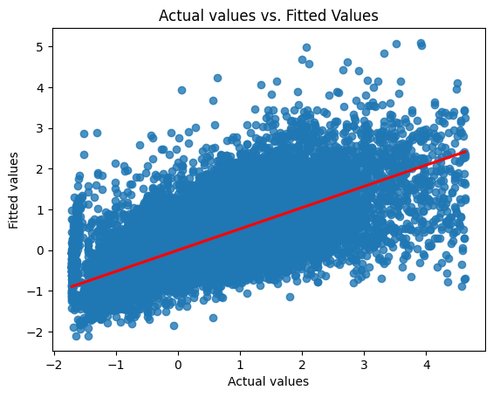
Multiple Linear Regression
R² | MSE
0.52203 | 0.47805

Slide 16

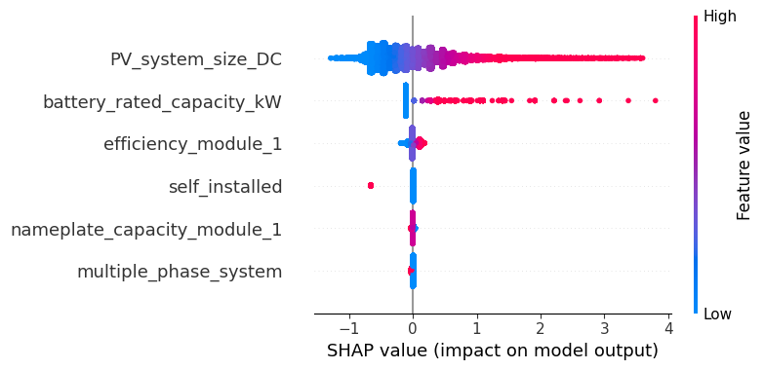
Findings
Predictor | Coefficient | P-value
PV_system_size_DC | 0.6525 | 0.000
battery_rated_capacity_kW | 0.2165 | 0.000
self installed | -0.1023 | 0.000
efficiency_module 1 | 0.0586 | 0.000
nameplate_capacity_module 1 | -0.0096 | 0.006
multiple_phase_system | -0.0088 | 0.011

Slide 17
Limitations
Data Limitation
Missing building characteristics omits valuable inputs for cost estimation (e.g., square footage, number of floors, roof details)
Model Limitation
Algorithm assumes linear relationships between variables, but real data shows looser correlation

Slide 18

Recommendations
Augment Data Inputs
Seek additional data sources to improve the predictive accuracy of the linear regression model for solar project costs.
Cost Efficiency Analysis
Examine cost per kilowatt generated to identify variables that can enhance economic efficiency.
Geographic Diversity
Expand the study to include diverse geographic regions for a more comprehensive predictive model.

Slide 19
Expected Benefits
Demonstrated Feasibility: Successful proof-of-concept for predicting residential solar project costs using multiple inputs.
Valuable Head-Start: Identified statistically relevant predictor variables to guide future model development.
Future Work Needed: Further efforts required to refine and build a comprehensive predictive model.

Slide 20
Thank you!
Christopher Fischer - 011933891
College of Information Technology, Western Governors University
Dr. Daniel Smith
January 4, 2025

